Slide 2
Chapter 8, LO1, key term
Describe the structure and function of the respiratory system
Define the following term:
respiration
the process of inhaling air into the lungs and exhaling air out of the lungs.

Slide 3
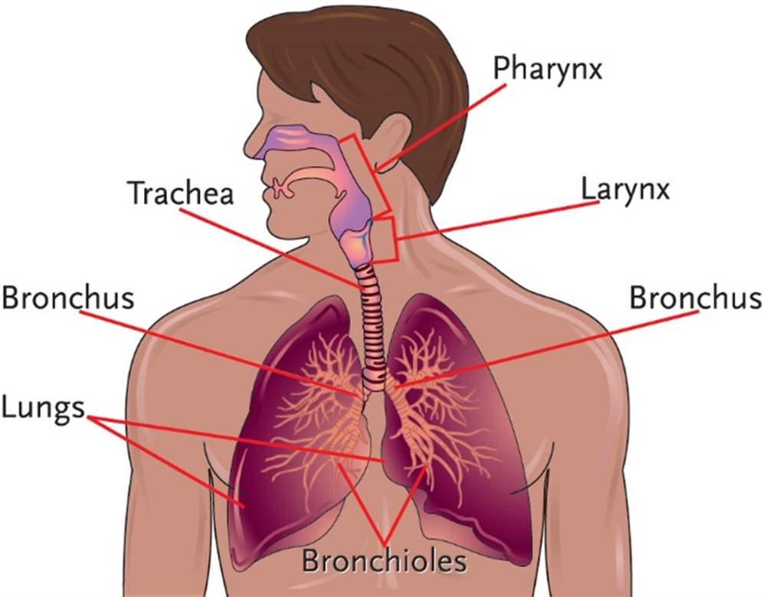
LO1, content 1
Key Material 8-1: The Respiratory System

Slide 4
LO1, content 2
Describe the structure and function of the respiratory system
Remember these points about the respiratory system:
Inspiration is breathing in and expiration is breathing out
Functions are
To bring oxygen into the body
To eliminate carbon dioxide produced by the body

Slide 5
LO1, content 3
Describe the structure and function of the respiratory system
Normal changes of aging include the following:
Decreased lung strength
Decreased lung capacity
Decreased oxygen in the blood
Weakened voice

Slide 6
LO2, key terms
Discuss common medications used to treat rhinitis, sinusitis, and asthma
Define the following terms:
rhinitis
inflammation of the mucous membranes lining the nasal passages.
sinusitis
inflammation of the lining of the sinuses.
asthma
a chronic inflammatory disease that causes difficulty breathing, coughing, and wheezing.

Slide 7
LO2, content 1
Discuss common medications used to treat rhinitis, sinusitis, and asthma
The following medications are used to treat rhinitis:
Intranasal corticosteroids
Intranasal antihistamines (for allergic rhinitis)
Intranasal saline
Oral antihistamines (for allergic rhinitis)
Oral decongestants
Leukotriene receptor antagonist
Table on textbook pp. 136–137 (or handout) details other specific drugs

Slide 8
LO2, content 2
Discuss common medications used to treat rhinitis, sinusitis, and asthma
The following medications are used to treat sinusitis:
Same medications indicated for rhinitis
Antibiotics may be ordered if symptoms are severe/last longer than 10 days
Table on textbook pp. 136–137 (or handout) details specific drugs

Slide 9
LO2, content 3
Discuss common medications used to treat rhinitis, sinusitis, and asthma
Understand the following about treatments for asthma:
Maintenance medications include
Inhaled corticosteroids
Inhaled long-acting bronchodilators
Combination medications (one metered dose inhaler containing medications from both classes)
Inhaled corticosteroids can cause sore throat and oral fungal infection (thrush); using a spacer and rinsing after use can prevent thrush
Rescue medications may be administered by metered dose inhaler or by nebulizer
Short-acting bronchodilators
Leukotriene receptor antagonist (oral) may be prescribed to reduce inflammation in the airways
Short course of oral corticosteroids may be ordered during asthma flare-ups
Table on textbook p. 137 (and on handout) details specific drugs

Slide 10
LO2, content 4
Discuss common medications used to treat rhinitis, sinusitis, and asthma
Care guidelines for rhinitis, sinusitis, and asthma include the following:
Before administering a medication by nasal spray, ask the resident to blow their nose
Report high fever/severe symptoms in resident with sinusitis; antibiotics may be needed
Report immediately to a nurse if a resident with asthma is experiencing difficulty breathing.
Shake metered dose inhalers well before administering
Assist residents who use inhaled corticosteroids to rinse their mouths afterward
Residents with asthma should avoid known triggers that bring on attacks (e.g., allergens, smoke, strong odors, strenuous exercise). Do not wear perfumes or strongly scented skin products to work

Slide 11
LO3, key terms
Discuss common medications used to treat influenza, bronchitis, and pneumonia
Define the following terms:
influenza
a respiratory illness caused by a virus; common in the fall and winter months.
bronchitis
an irritation and inflammation of the lining of the bronchi.
pneumonia
a bacterial, viral, or fungal infection that causes acute inflammation in lung tissue, causing fever, chills, cough, greenish sputum, chest pains, and rapid pulse.

Slide 12
LO3, content 1
Discuss common medications used to treat influenza, bronchitis, and pneumonia
Understand the following about treatment for influenza:
Influenza vaccination can prevent infection
Antiviral medications can reduce severity of influenza if taken early on
Symptoms may be managed with OTC medications (as ordered/documented in the MAR):
Analgesics
Decongestants
Table on textbook p. 138 (or handout) details specific drugs

Slide 13
LO3, content 2
Discuss common medications used to treat influenza, bronchitis, and pneumonia
Understand the following about treatment for bronchitis:
Analgesics/antipyretics can control headache and fever
Antitussive agents can help control cough
Expectorants thin mucus in the lungs, making it easier to cough out
Antibiotics are only used to treat bronchitis when pneumonia is suspected
Table on textbook p. 138 (or handout) details specific drugs

Slide 14
LO3, content 3
Discuss common medications used to treat influenza, bronchitis, and pneumonia
Understand the following about treatment for pneumonia:
Antibiotics
Type used depends on the resident/history of antibiotic use
Also depends on whether the pneumonia is hospital- or community-acquired; hospital-acquired pneumonia is treated with specific antibiotic agents
Table on textbook p. 138 (or handout) details specific drugs

Slide 15
LO3, content 4
Discuss common medications used to treat influenza, bronchitis, and pneumonia
Care guidelines for influenza, bronchitis, and pneumonia include the following:
Wash your hands often. Get an annual flu vaccine
Be careful when administering OTC medications for cold/flu. Many have multiple ingredients. Do not exceed maximum daily dosages (report concerns to nurse)
Some OTC cold, flu, and cough medications can increase blood pressure and are contraindicated for residents with hypertension. Report concerns to the nurse
Position residents upright when administering oral medications to prevent aspiration pneumonia (caused by inhaling liquids or solids into the lungs)

Slide 16
LO3, content 5
Discuss common medications used to treat influenza, bronchitis, and pneumonia
Care guidelines for influenza, bronchitis, and pneumonia (cont’d):
Observe residents closely for signs/symptoms of pneumonia. Report these signs immediately:
High fever
Worsening cough
Chest pains
Rapid pulse
Recovery from pneumonia may take longer for older adults and people with chronic illnesses

Slide 17
LO4, key terms
Discuss common medications used to treat chronic obstructive pulmonary disease (COPD)
Define the following terms:
chronic obstructive pulmonary disease
a chronic, progressive, and incurable lung disease that causes difficulty breathing, weakness, and a high risk for lung infections.
emphysema
a chronic disease of the lungs that usually results from chronic bronchitis and ciga­rette smoking.

Slide 18
LO4, content 1
Discuss common medications used to treat chronic obstructive pulmonary disease (COPD)
Understand the following about treatment for COPD:
If a resident with COPD smokes, quitting is the first line of treatment
Medications include the following
Oxygen therapy
Short-acting bronchodilators
Long-acting bronchodilators
Roflumilast reduces lung inflammation
Table on textbook p. 139 (or handout) details other specific drugs

Slide 19
LO4, content 2
Discuss common medications used to treat chronic obstructive pulmonary disease (COPD)
Care guidelines for COPD include the following:
Encourage residents who are trying to quit smoking
Colds or viruses can make COPD worse. Observe and report signs/symptoms of respiratory illnesses
Use proper technique when administering inhaled medications to ensure maximum effectiveness
Do not administer or adjust oxygen if you are not trained to do so. Report to a nurse if there is a problem with a resident’s oxygen

Slide 20
LO5, key terms
Discuss common medications used to treat pleurisy, atelectasis, and pulmonary embolism (PE)
Define the following term:
pleurisy
a condition caused by inflammation of the thin layers of tissue that separate the lungs from the chest wall (the pleura).
atelectasis
a condition in which a lung becomes blocked and unable to expand as it should.
pulmonary embolism
a blood clot or other blockage found in the lung.

Slide 21
LO5, content 1
Discuss common medications used to treat pleurisy, atelectasis, and pulmonary embolism (PE)
Treatment for pleurisy involves the following:
Treatment of any underlying condition (e.g., injury to the chest, infection)
Analgesics (NSAIDs, acetaminophen)
Table on textbook p. 139 (or handout) details specific drugs

Slide 22
LO5, content 2
Discuss common medications used to treat pleurisy, atelectasis, and pulmonary embolism (PE)
Understand the following about treatment for atelectasis:
Mucolytics break up mucus and may be ordered if excessive mucus in the lung is the cause
Continuous positive airway pressure (CPAP) machine (if cause is not mucus)
Oxygen may also be ordered
Table on textbook p. 139 (or handout) details specific drugs

Slide 23
LO5, content 3
Discuss common medications used to treat pleurisy, atelectasis, and pulmonary embolism (PE)
Understand the following about treatment for pulmonary embolism:
Anticoagulants by injection or IV immediately after diagnosis
Oral anticoagulants for an extended time to prevent further clots
Table on textbook p. 140 (or handout) details specific drugs

Slide 24
LO5, content 4
Discuss common medications used to treat pleurisy, atelectasis, and pulmonary embolism (PE)
Care guidelines for pleurisy, atelectasis, and pulmonary embolism include the following:
Report any signs of difficulty breathing with pleurisy. Labored breathing can be a sign that complications are developing
Do not use CPAP or oxygen delivery equipment if you are not trained/allowed by state law and facility policy to do so
In severe cases of atelectasis a chest tube may be inserted to remove air from the chest cavity Observe residents for signs/symptoms of breathing problems or cyanotic skin. Report these changes immediately

Slide 25
LO5, content 5
Discuss common medications used to treat pleurisy, atelectasis, and pulmonary embolism (PE)
Care guidelines for pleurisy, atelectasis, and pulmonary embolism (cont’d):
Remember that residents taking anticoagulants are at increased risk for bleeding. Observe for signs/symptoms:
Excessive bruising
Blood in urine
Dark/tarry stools
Abdominal cramping

Slide 26
LO6, key terms
Discuss common medications used to treat tuberculosis (TB)
Define the following terms:
tuberculosis (TB)
a highly contagious lung disease that causes fatigue, loss of appetite, slight fever, prolonged coughing, and shortness of breath.
multidrug-resistant TB (MDR-TB)
type of tuberculosis caused by an organism that is resis­tant to medication used to treat TB.
resistant
a state in which drugs no longer work to kill specific bacteria.

Slide 27
LO6, content 1
Discuss common medications used to treat tuberculosis (TB)
Understand the following about treatment for tuberculosis (TB):
Two treatment phases: intensive phase and continuation phase
Intensive phase involves four antibiotics administered together for eight weeks
Continuation phase involves two of the four continued for four months
Adverse effects of TB medications can include Stevens-Johnson syndrome (SJS), a severe skin reaction
Other effects can include joint and muscle pain, increased liver enzymes, gout, visual problems, confusion, and hallucinations
Failure to finish TB medications can lead to a drug-resistant form of the disease
Table on textbook p. 140 (or handout) details specific drugs

Slide 28
LO6, content 2
Discuss common medications used to treat tuberculosis (TB)
Care guidelines for tuberculosis include the following:
TB is highly contagious. Follow Standard Precautions and Airborne precautions when administering medications to residents with TB
Wear PPE as instructed
Residents with TB will be placed in an airborne infection isolation room (AIIR). When entering this room do not open or close the door quickly. This can pull contaminated room air into the hallway
Provide encouragement when administering TB medications. Failure to take all medication is a major factor in the spread of TB

